Slide 1


Optimal Cargo Management
Inter IIT Tech Meet 13.0 Team 32

Slide 2
Greedy Filling

Slide 3
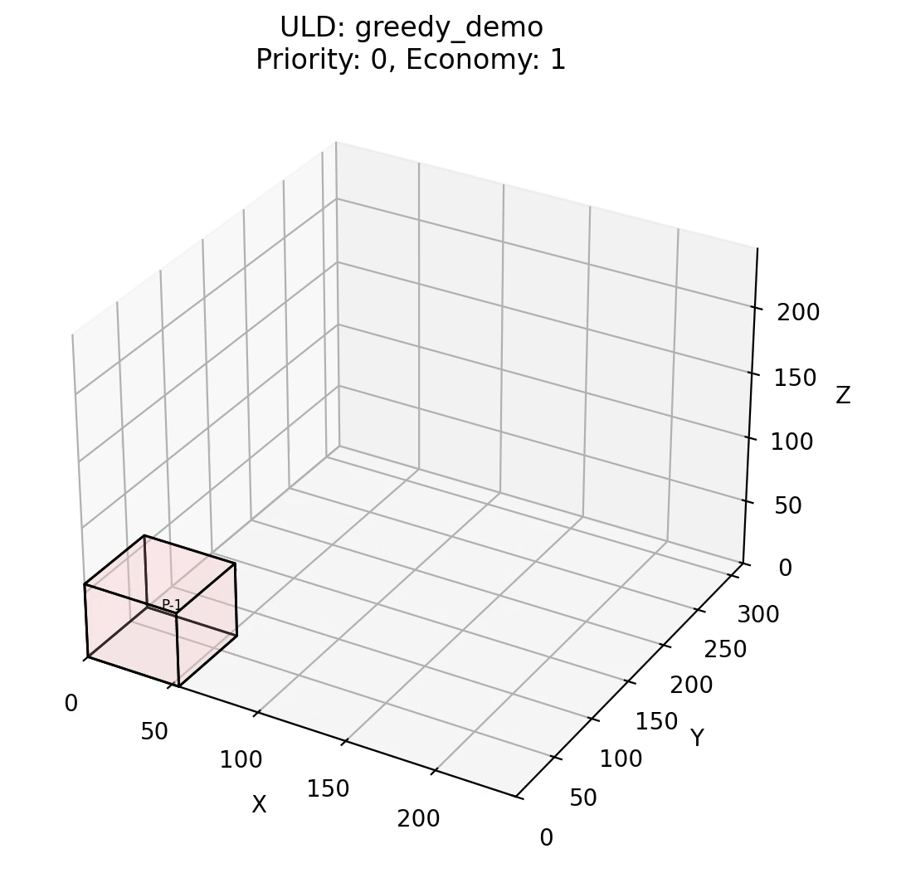
Greedy Filling
Simple, Fast and Greedy
Pack boxes layer by layer within the ULD, where each layer is filled row by row.
A single layer (or plane) is completed before moving to the next, ensuring systematic packing.
Problem: Deciding the orientation of packages

Slide 4
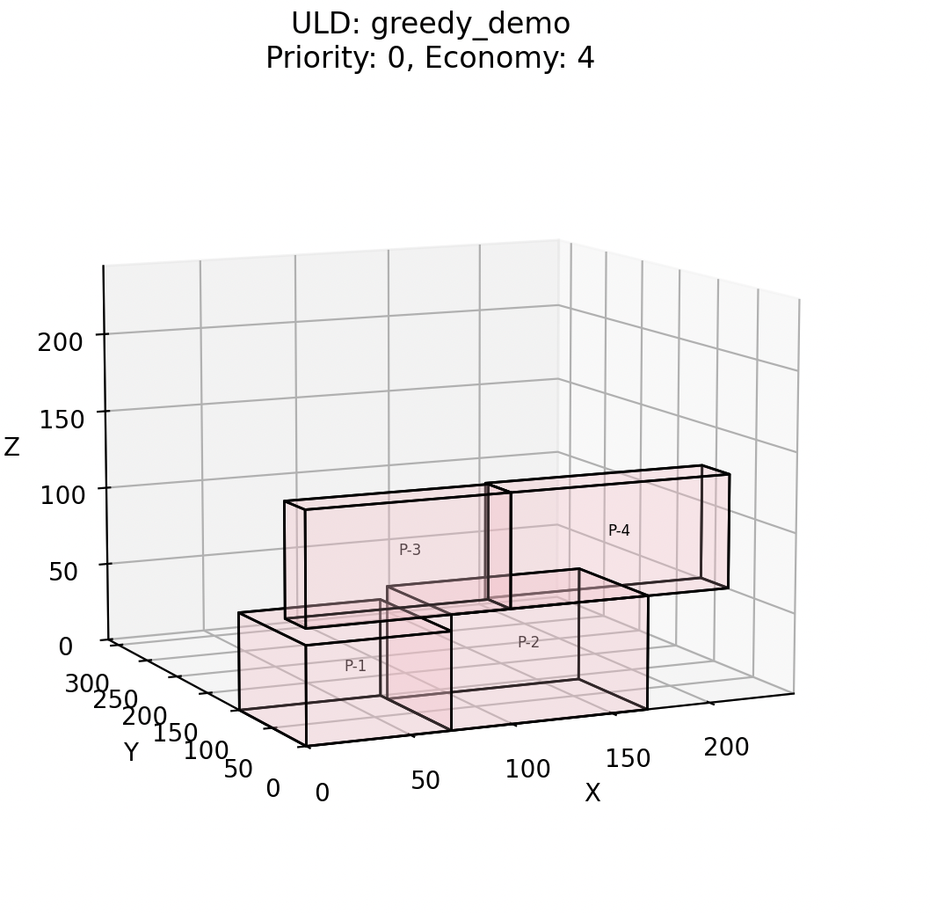
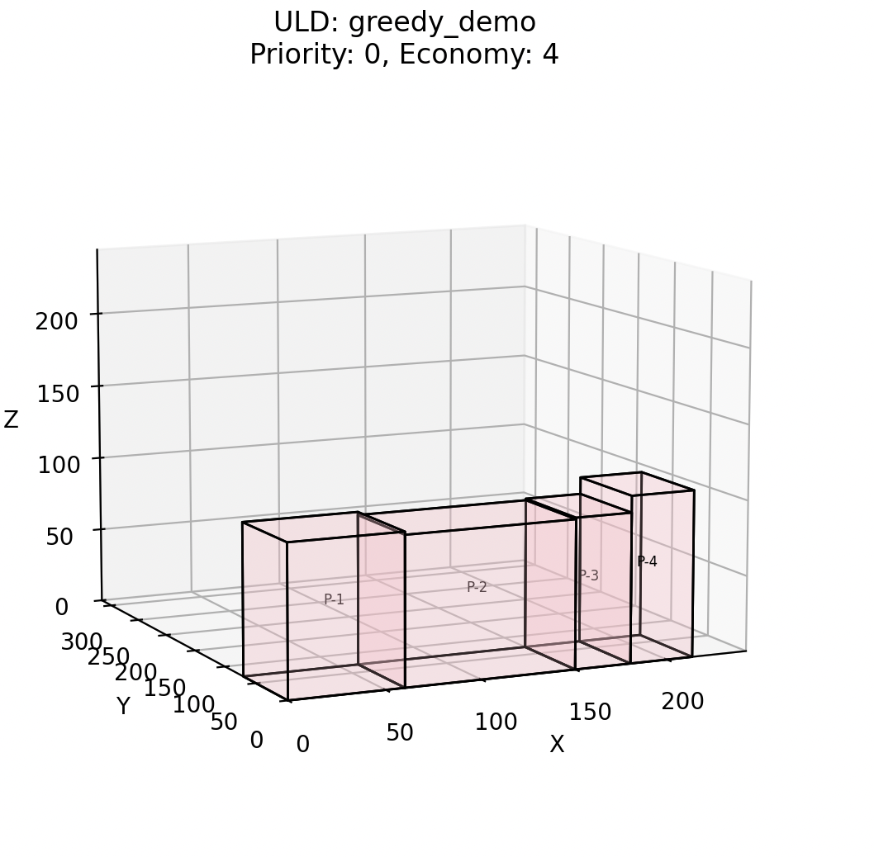
Crainic Sorting
Deciding the Orientation of Packages
Group packages into groups that have similar dimension magnitudes
Groups are prioritized by size, with larger groups (greater shared dimensions) packed first
Within each group, boxes are placed to maximize the number of planes filled in the ULD (by orienting the package to have the larger dimension along the height)
Before “Crainic” Sorting
After “Crainic” Sorting

Slide 5
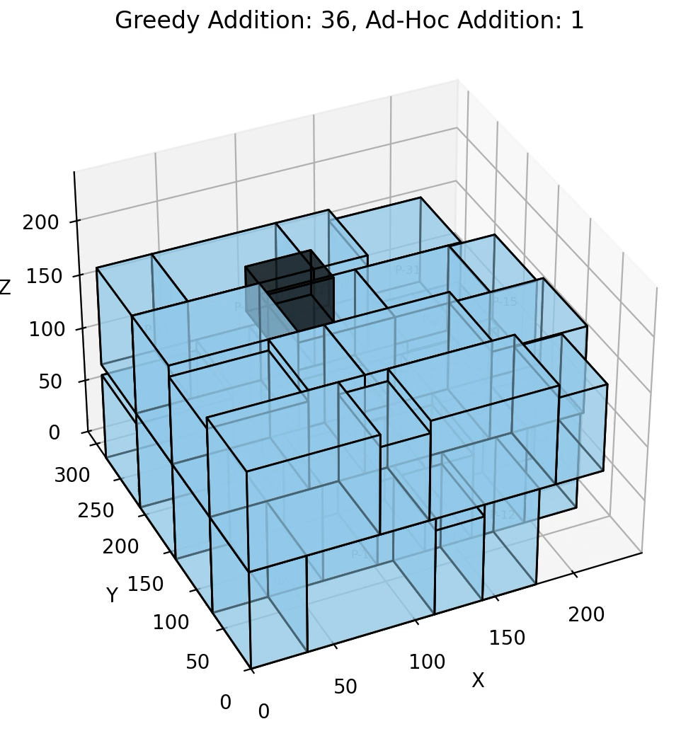
Ad-Hoc Addition
Making the best use of the remaining space
If it is possible to fit an package into a given space, one corner of the package can always coincide with the empty space's corner
Identify all 48 orientations of a package at all the possible corners of the filled space (6 Rotational X 8 Quadrants)
Choose a point and package orientation out of the possible combinations

Slide 6
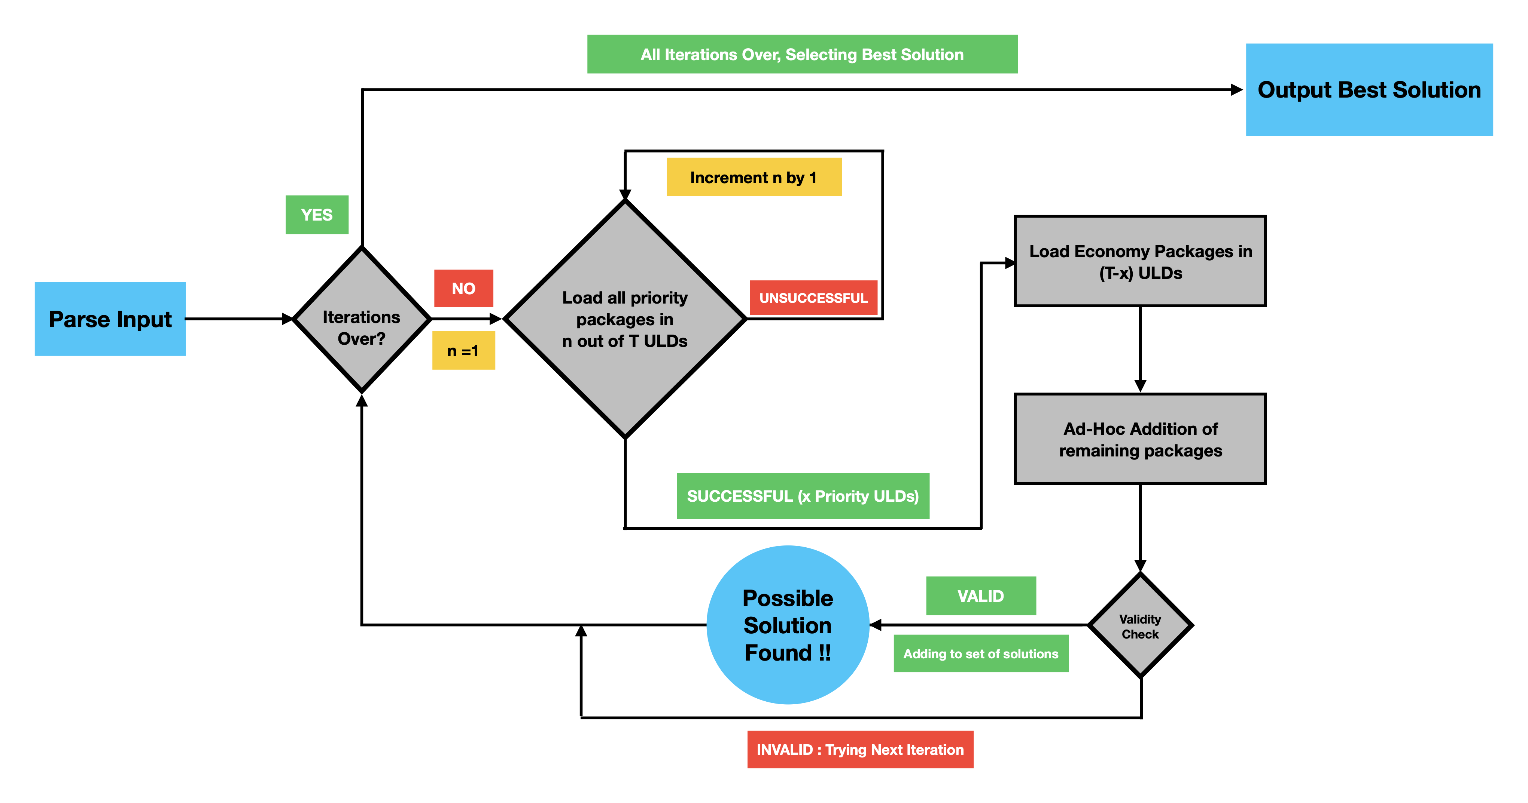
Flow

Slide 7
EMS Filling

Slide 8
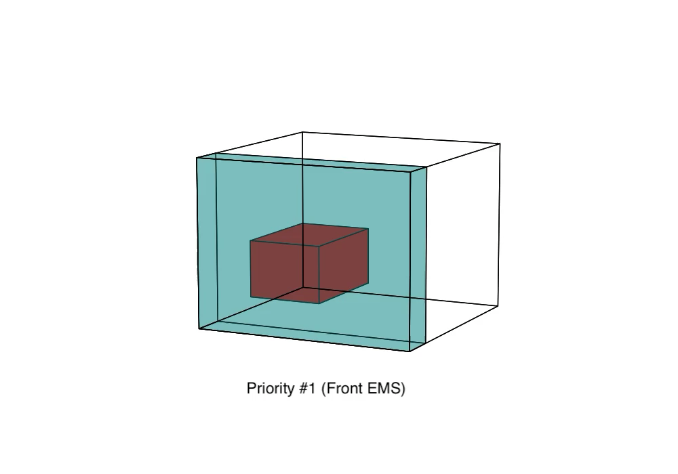

Empty Maximal Spaces
A better greedy strategy
EMS is the largest available free space in a bin not fully enclosed by other spaces
We update EMS regions on the fly while filling packages
Priority Heuristic: Based on smallest coordinate value, starting with x, followed by y and z
[1] Priority Heuristic inspired from Li et al. (2014)

Slide 9
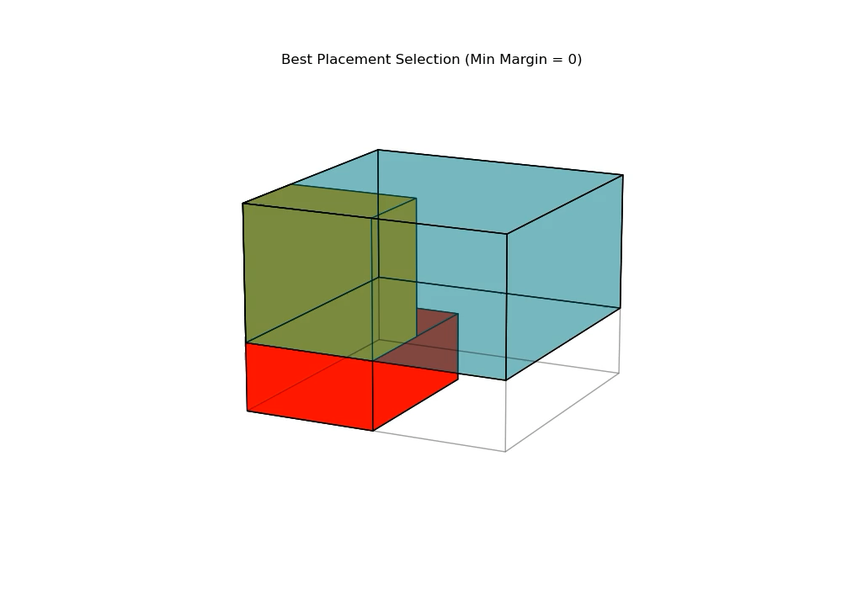
Best Placement Selection
Fitting packages in EMS optimally
Based on the Packing Sequence and EMS priority, we score a subset of boxes and EMS regions
Feasible box-EMS pairs are scored using margin (distance to EMS edges, wherein we try to rotate and fit the package)
The pair with the highest priority is selected for placement
Question? What is the package packing order?

Slide 10
Evolutionary Algorithm
AKA Genetic Algorithm in AI Literature

Slide 11
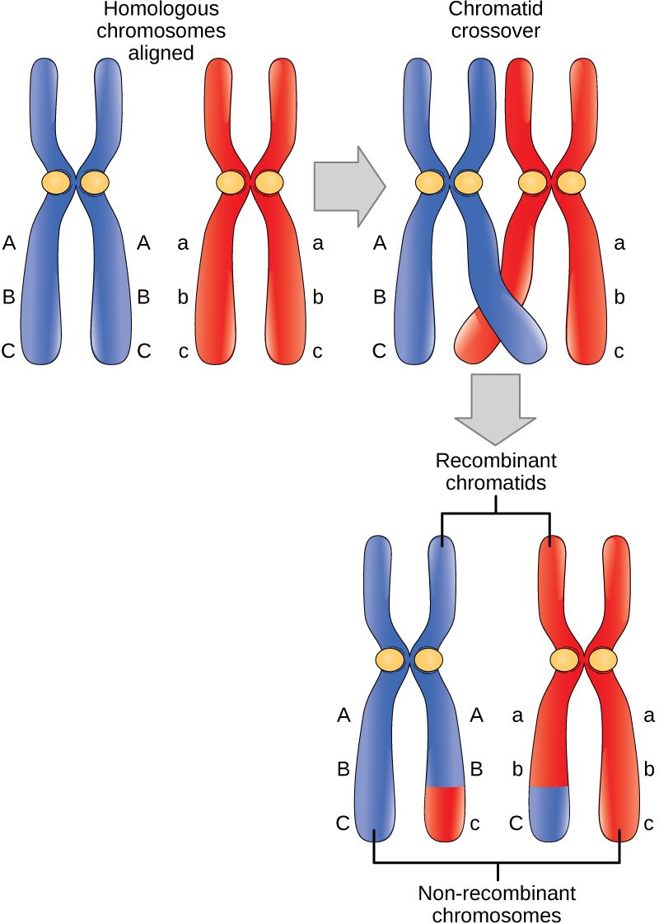
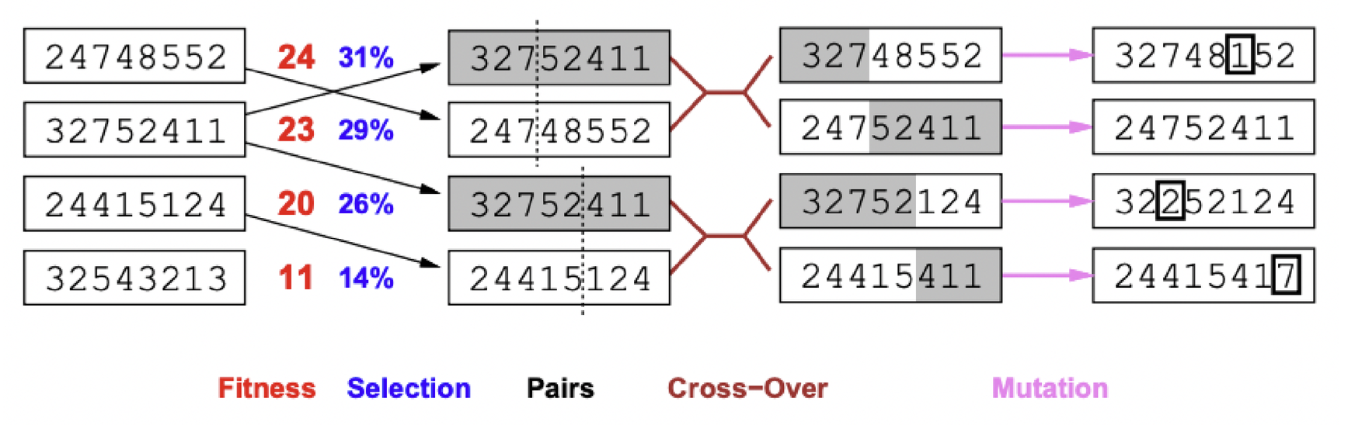
Evolutionary Algorithm
From Biology to AI
Start with a Initial population
Calculate Fitness values
Select Top Candidates
Crossover parents using a probability distribution
Mutate at random spots using a probability distribution
Retain some Elite candidates
Repeat
Stop when termination condition is met
Return the Best solution from the final population
Question? How to get these ingredients? Solution Representation and a Fitness Function
Figures from Russell & Norvig’s Artificial Intelligence: A Modern Approach (3rd Edition)

Slide 12
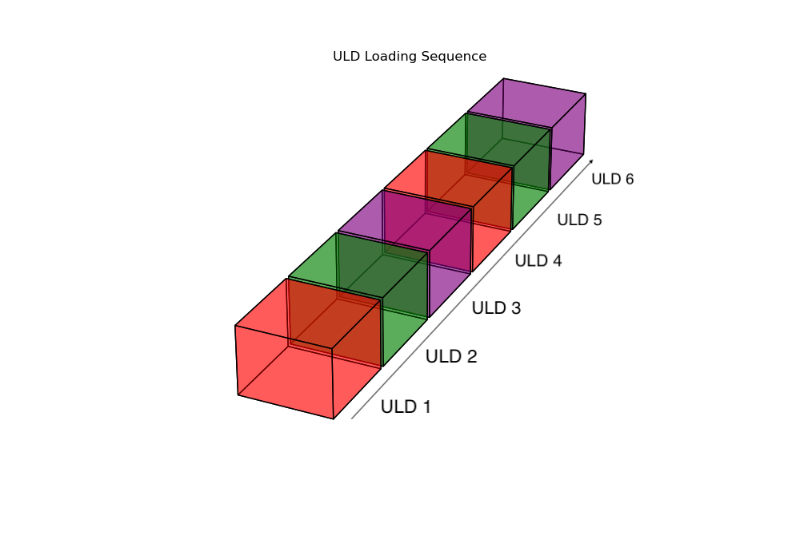
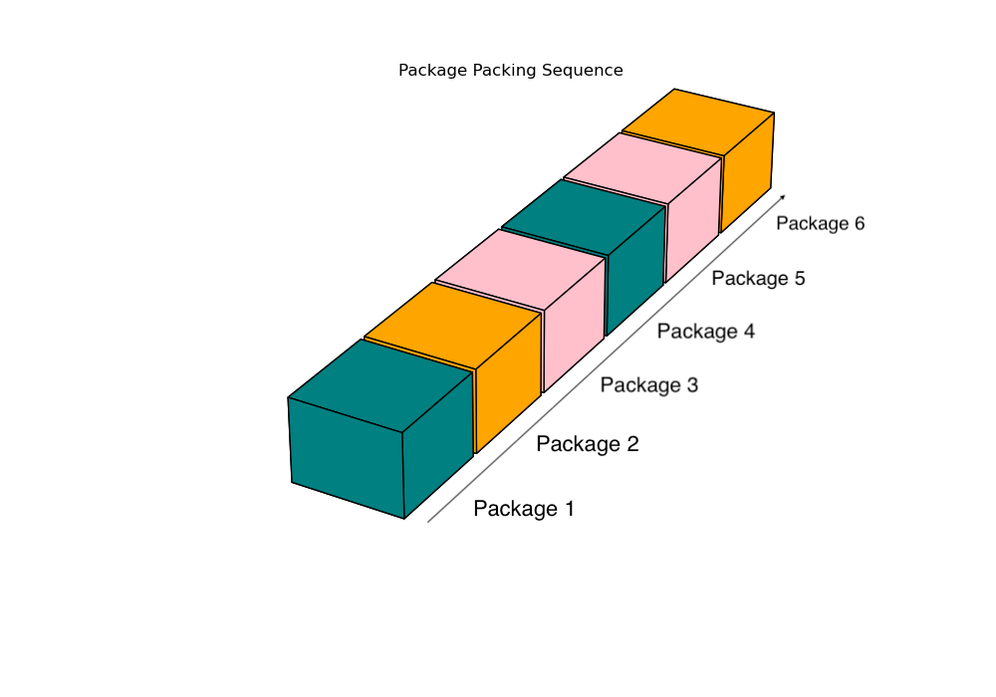
Getting the Ingredients
Laying the groundwork
ULD Loading Sequence : A permutation of ULDs to define the order of ULD usage
Package Packaging Sequence : A permutation of the set of packages to define the packing order
Mutation: Swap genes at two random positions (corresponding to the sequences) in a chromosome
Fitness: Total packing fraction corresponding to the volume for all containers
Crossover: Has multiple crossover points

Slide 13
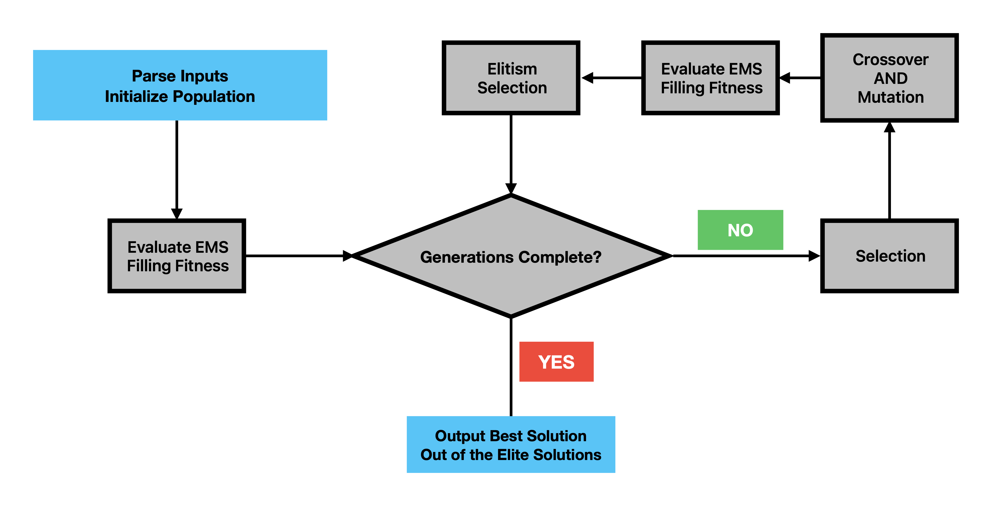
Flow

Slide 14
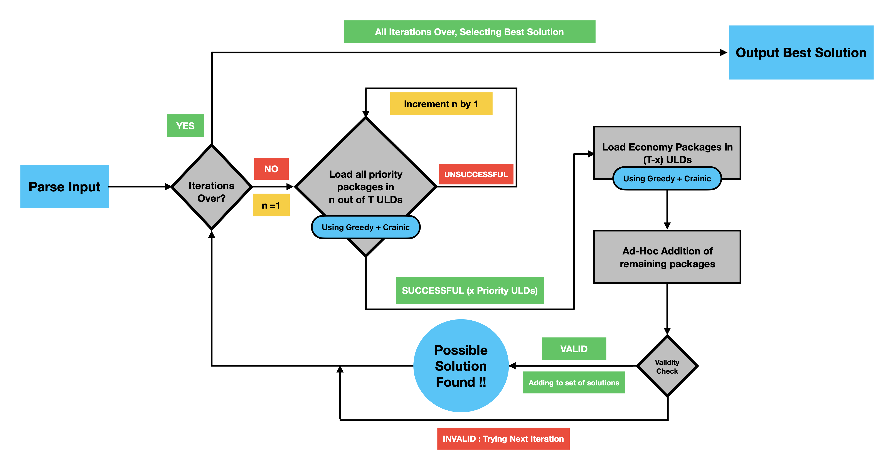
Before

Slide 15

After

Slide 16
The best of both worlds

Slide 17
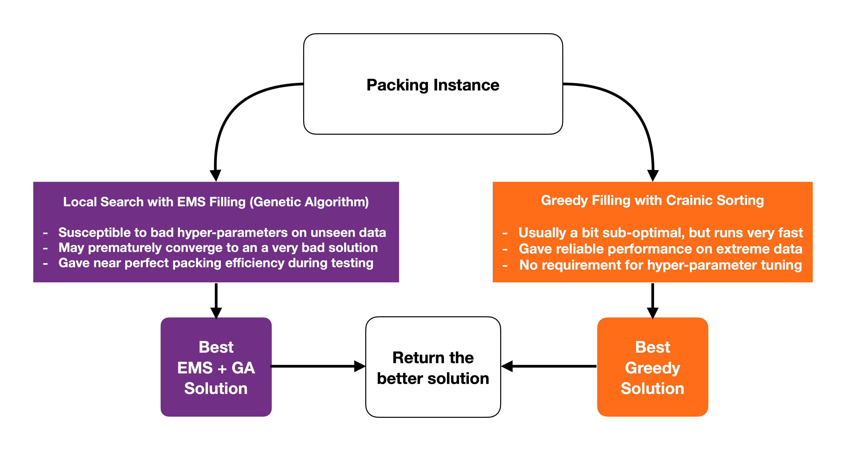
Flow

Slide 18
Visualization

Slide 19
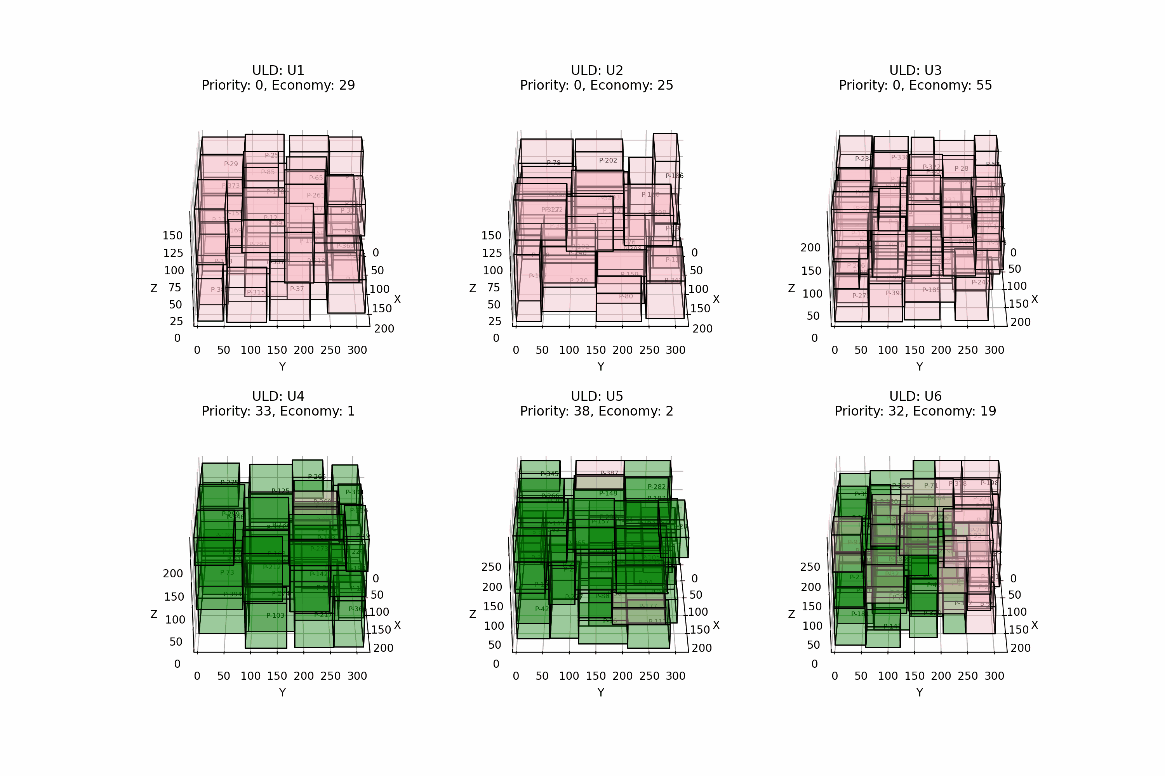
FedEx Challenge 6 ULDs and 400 Packages 297 Economy + 103 Priority
ULD | Weight Fill % | Volume Fill %
U1 | 60.7 | 74.8
U2 | 61.9 | 71.1
U3 | 96.2 | 81.8
U4 | 97.1 | 82.1
U5 | 95.9 | 78.9
U6 | 82.2 | 76.3
Challenge Cost = 30111 Runs in under 3 minutes

Slide 20
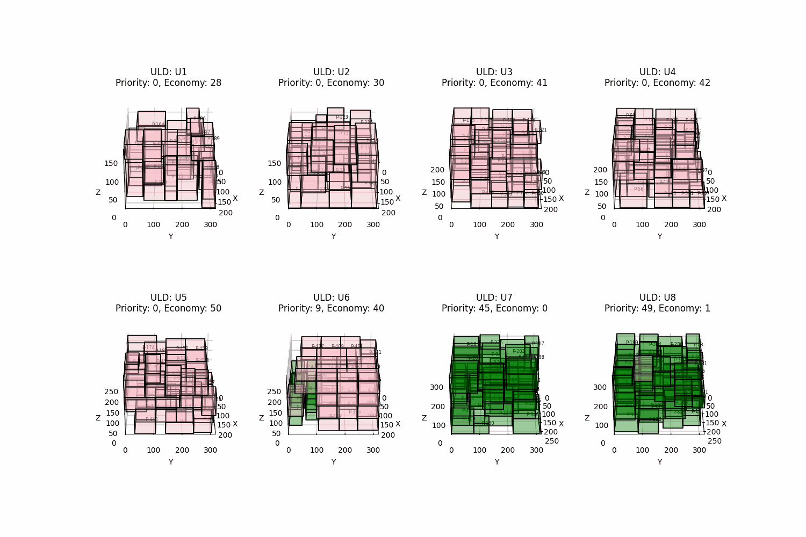
Custom Test 8 ULDs and 600 Packages 497 Economy + 103 Priority
ULD | Weight Fill % | Volume Fill %
U1 | 50.4 | 60.6
U2 | 61.6 | 75.7
U3 | 59.1 | 70.1
U4 | 68.7 | 70.5
U5 | 50.2 | 65.9
U6 | 55.2 | 69.8
U7 | 92.7 | 77.8
U8 | 78.9 | 76.4

Slide 21
Thanks! We are open for Q&A

Slide 22
Appendix
Why not use Machine Learning?
Limited Training Real-World Dataset
Large Inference Time
State Space is very large
Bulky Models
Time vs Accuracy Tradeoff

Slide 23
Appendix
Time and Space Complexity
NP-Hard theoretically no Polynomial Solution exists (P $≠$ NP)
EMS Packing Procedure $O(enm)=O(n^{2}m)$ $n$ - length of Package Packing Sequence $m$ - length of ULD Loading Sequence $e=O(n)$ - Empty Maximal Spaces Space Complexity - $O((n+m)⋅C)$ where $C$ represents a constant for storing the EMS, box information
Genetic Algorithm $O(G⋅n⋅P)⋅O(n⋅n⋅m)=O(G⋅P⋅n^{3}⋅m)$ $O(P⋅n)$ chromosome “steps” in every iteration (crossover, mutation) in $G\text{generations},$$P\text{initial population and}$$e\text{elitism size}$ Space Complexity - $O((P+e)⋅n)$
Ad-Hoc Addition $O(n)$ per ad-hoc addition (Constant number of checks at every possible corner) Space Complexity - $O(n)\text{per iteration}$

Slide 24
Appendix
GA Hyperparameters
Delay/(Volume^x): Choice for x
Cross-Over Probability | 0.5
Mutation Probability | 0.5
Elitism Size | 5
Population Size | 20
x | Rough Cost
1.0 | 31.1
0.5 | 31.5
1.5 | 30.5
1.2 | 30.1
1.1 | 30.2
1.3 | 30.4
2.0 | 31.1

Slide 25
Appendix
Other approaches that we tried
Tried Laying the maximum dimension along the length instead of height Produces lesser number of Greedy Planes, lesser scope of Ad-Hoc Addition
Other Forms of Local Search - Stochastic Beam Search, Hill Climb Search etc
Different Criteria for Loading Economic Packages
Forced Shifting of Priority Packages to reduce Priority ULDs
Reviewed research papers on DL/ML methods

Slide 26
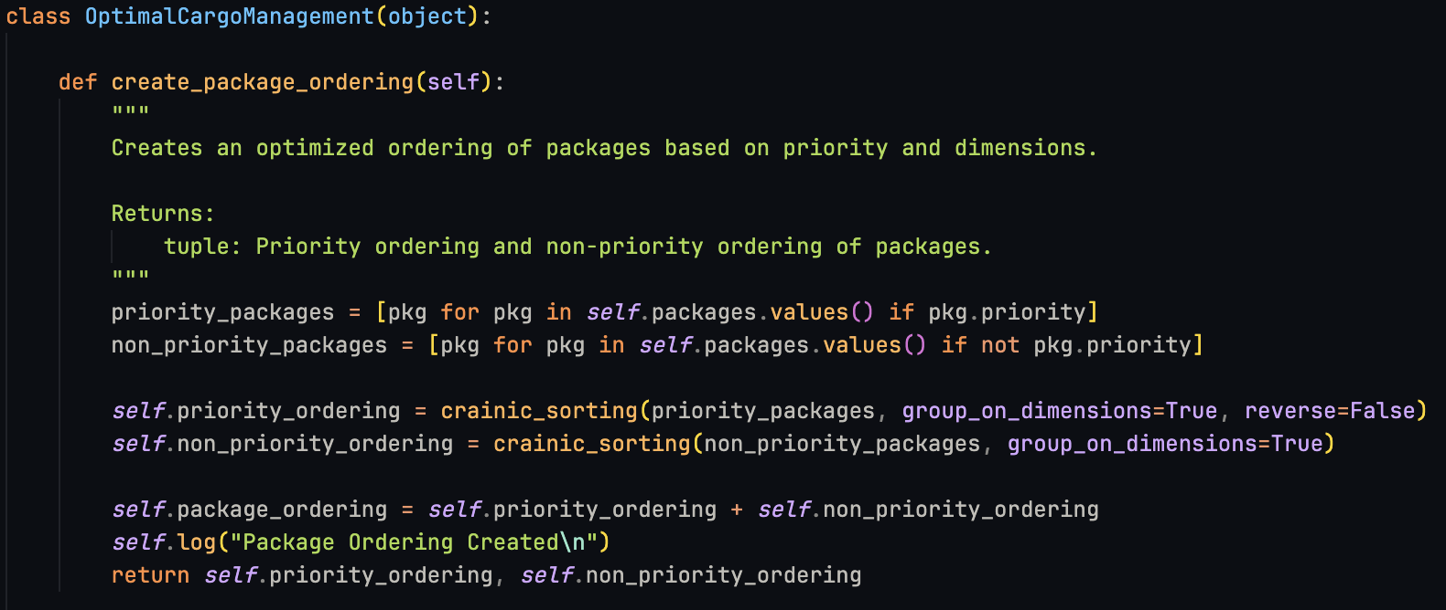
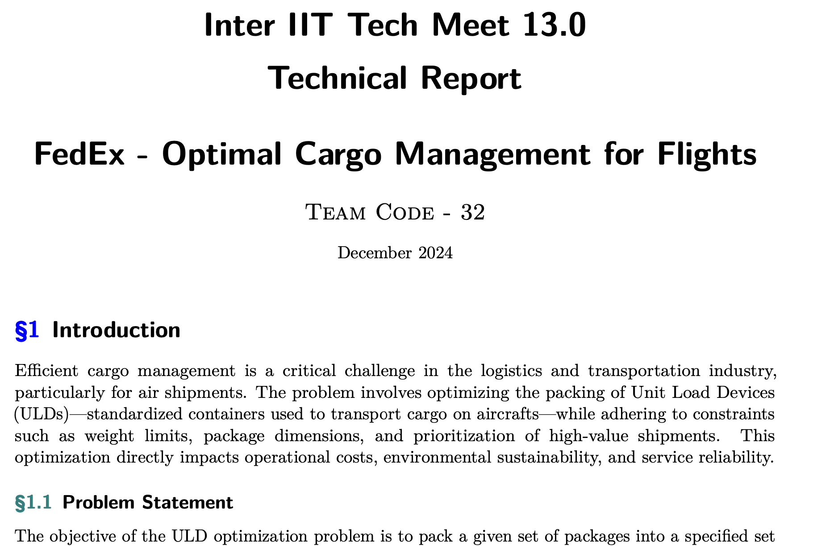
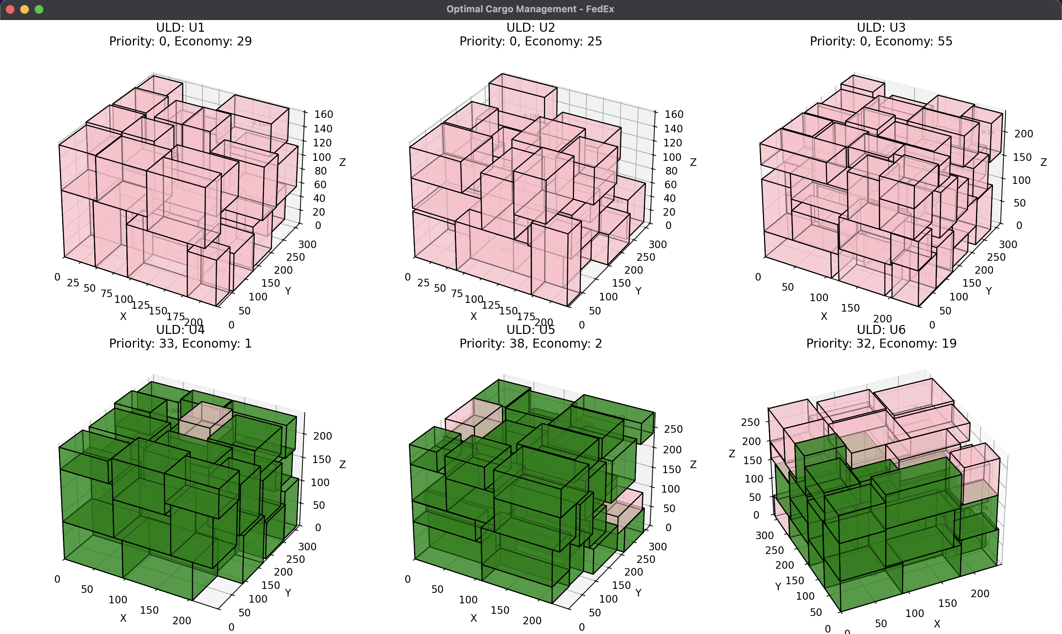
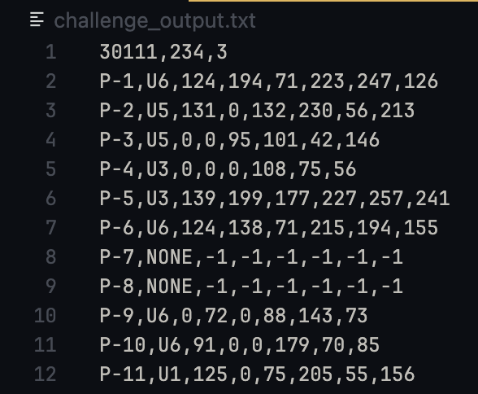
Appendix
Our Solution Package
Well-documented Python Script
README.md to run the package
Report with references
Answer to the FedEx Challenge
Visualizer

